Slide 1
ABB Innovation center
May 2025

Slide 2
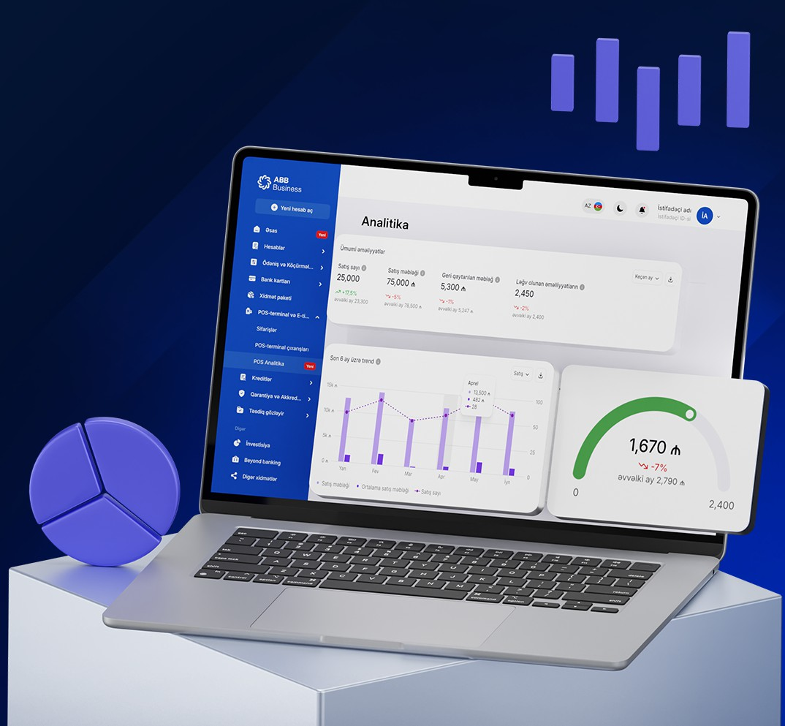
Internet Banking service
Internet Banking” service (İB service) –
A banking service that enables customers to manage their accounts remotely.

Slide 3
Formalization of the Internet Banking service
New enrollment
Additional applications
Contract
Application for the change of Internet Banking service user
Application for correction and termination of Internet Banking information”
Application for the use of banking services

Slide 4
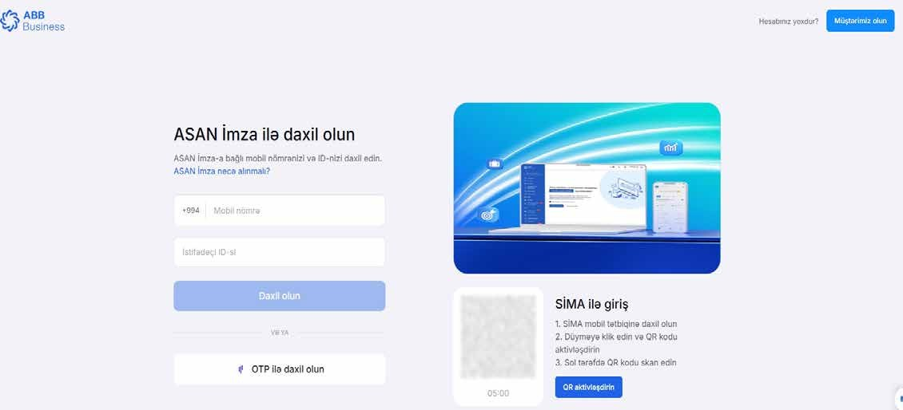
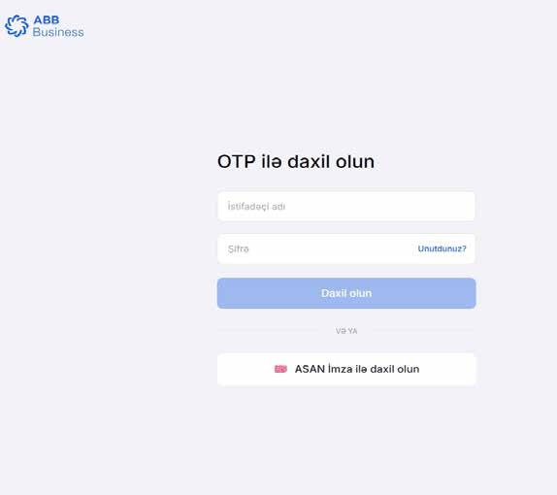
Types of access to Internet Banking service
https://cb.abb-bank.az/login
Asan imza
Kobil OTP: (Virtual and physical)

Slide 5
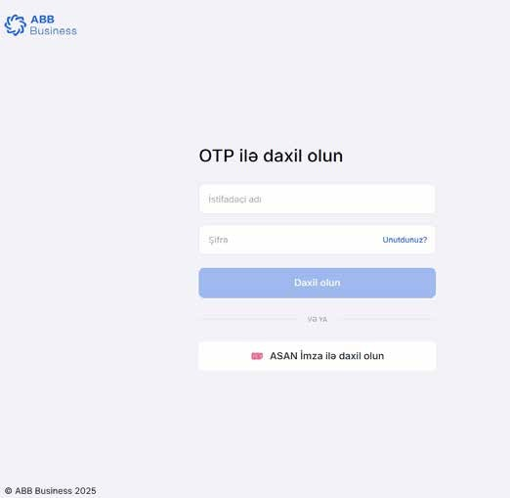
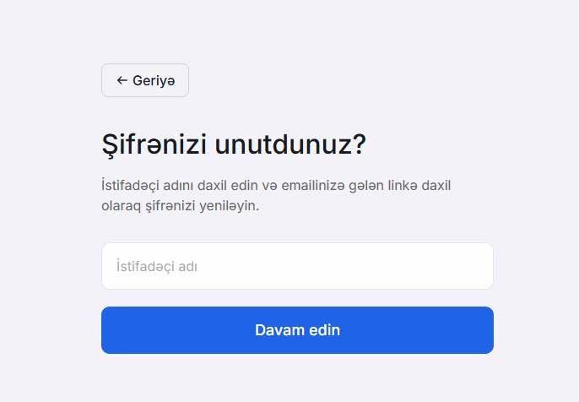
Access to Internet Banking service via Kobil OTP (physical token)
Access via Kobil OTP (physical token):
Click on the “Forgot Password” option, then in the opened window, enter your Username and reset your password. A link will be sent to the email address registered with the bank (the email provided in the Internet Banking application). Use this link to reset your password. The password must be at least 12 characters long and include uppercase and lowercase letters, numbers, and special characters (such as *, &, #, +, -, etc.).
After resetting your password, return to the main page of the Internet Banking service, enter your Username and the newly set password, then enter the OTP code (8 digits) in the OTP field.

Slide 6
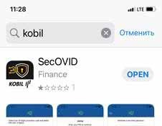
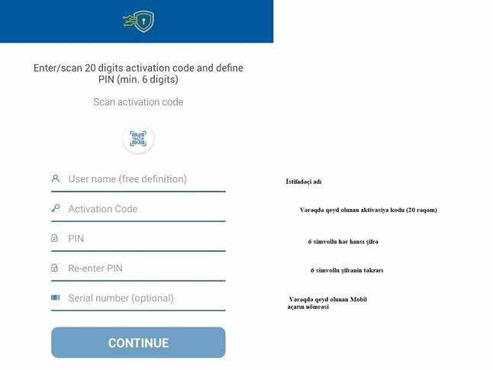
Access to Internet Banking service via Kobil OTP (virtual token)
Via Kobil OTP (virtual token):
Download the Kobil Secovid mobile application Complete the registration

Slide 7
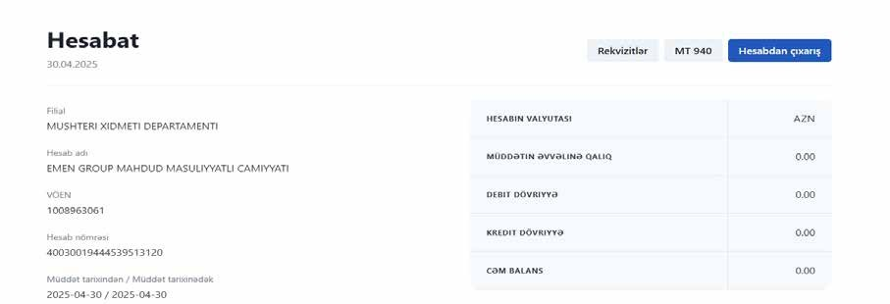
Accounts
Via Kobil OTP (virtual token) :
It is possible to monitor account transactions and orders from the Accounts section, as well as to subscribe to SMS/email notification services. By selecting an active account, you can obtain general information about the account, account statements (in Excel/PDF formats), account details, and statements in MT 940 format.

Slide 8
Bank cards
From the Cards section, it is possible to order, renew, and replace Salary, Business, Corporate, and Customs cards. At the same time, reports on expired salary accounts and cards opened in Internet Banking can also be obtained.

Slide 9
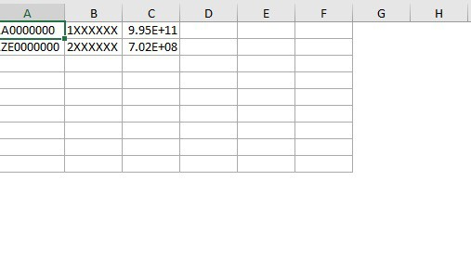
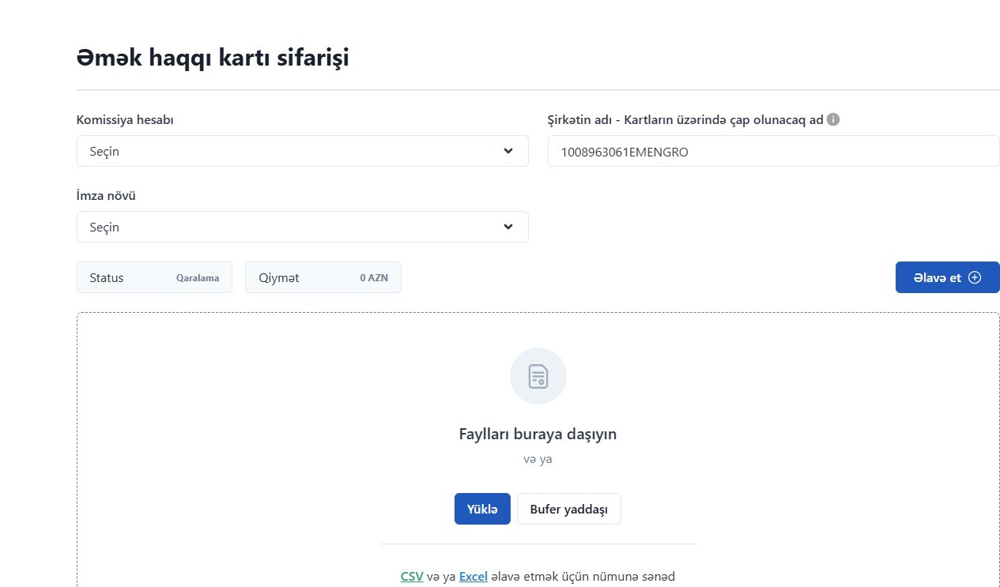
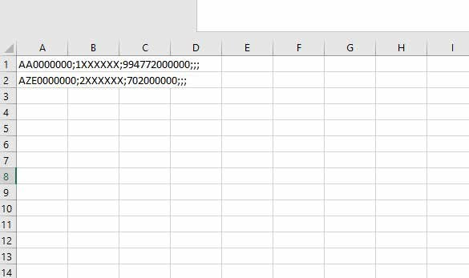
Salary card orders
For ordering salary cards, the employee’s ID FIN code, ID serial number, and mobile phone number must be provided. The process can be carried out using two methods:
Individual order
Bulk orders (by uploading a table in Excel or CSV format)

Slide 10
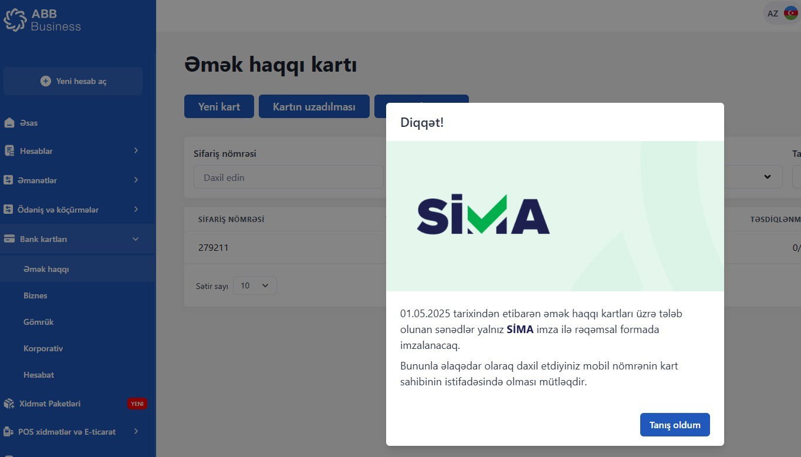
Salary card orders
Terms and Conditions:
The entered FIN is verified to ensure that the employee placing the order belongs to the company executing the order, and the validity of the employee’s ID card is checked. The provided mobile phone number must be personal and unique (not duplicated).
SMS notification.
Urgent card order.
Documents required for card orders must be digitally signed using a SIMA signature.
It is possible to place a new card order based on a Permanent Residence Permit (PRP).

Slide 11
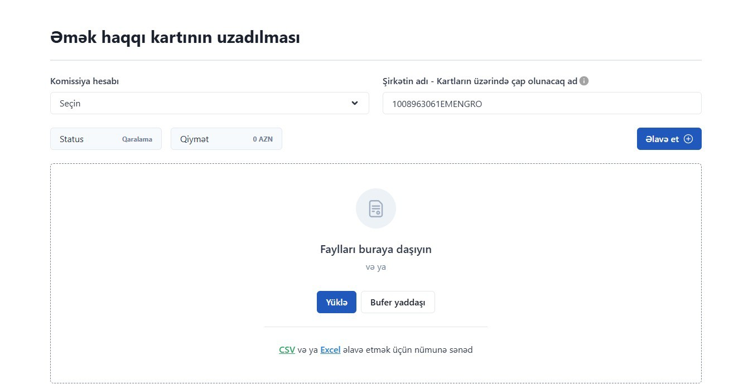
Salary card orders
The process is carried out based on the ID card serial number, ID card FIN code, and account or card number.
During bulk orders, CSV or Excel files are used in the system.

Slide 12
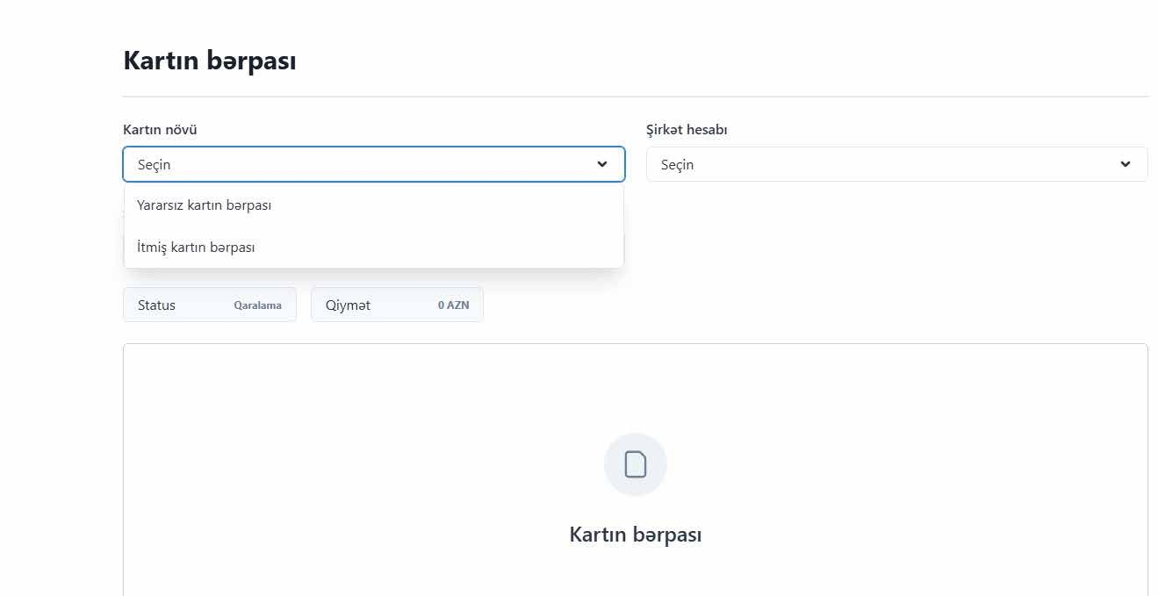
Card replacement
Two options are offered in the card replacement process: replacement of a damaged card and replacement of a lost card.
The process is carried out based on the ID card serial number, ID card FIN code, and account or card number.

Slide 13
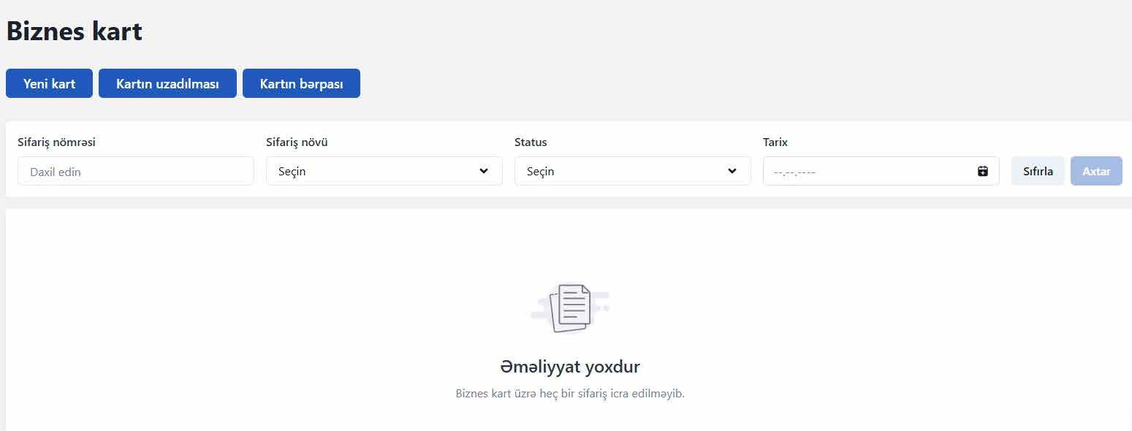
Ordering, renewal, and replacement of business cards
Terms and conditions:
During the order process, the ID card serial number, ID card FIN code, and mobile phone number must be provided.
SMS notification.
Urgent card orders.
Business cards can be ordered in AZN, USD, EUR, and GBP currencies..

Slide 14
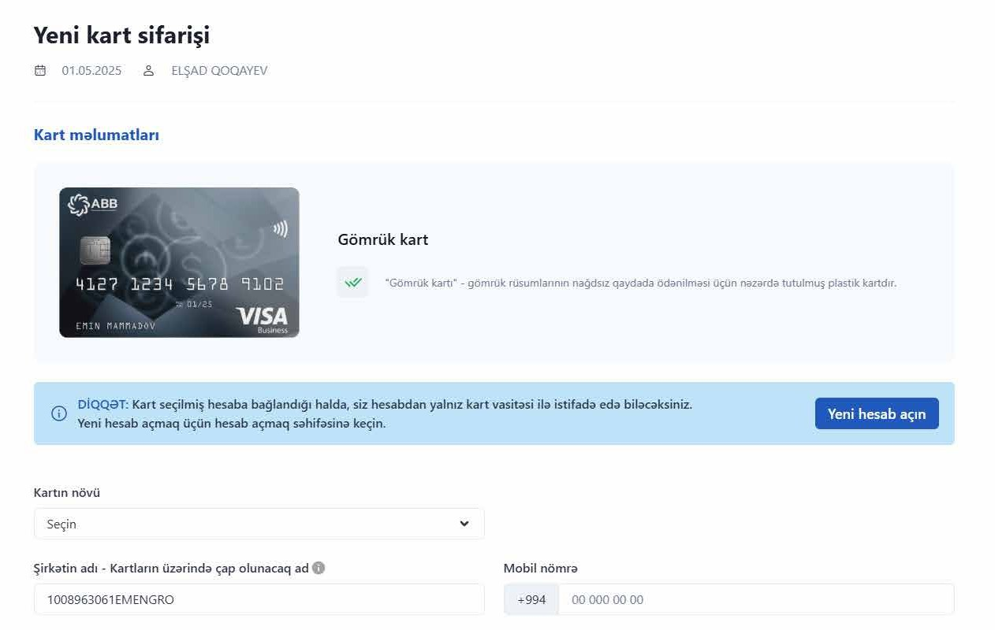
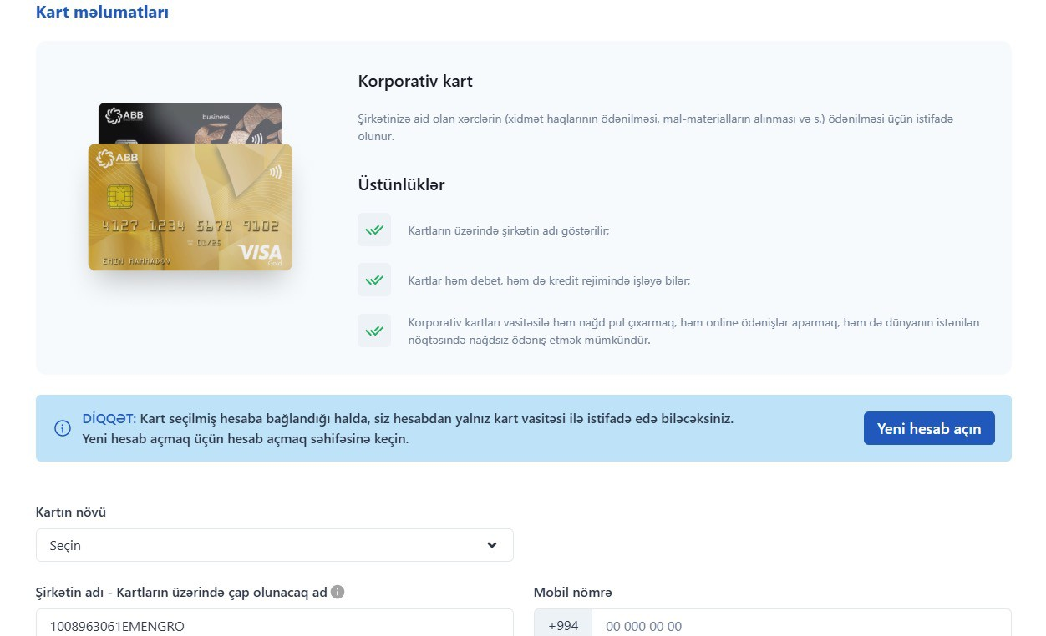
Bank cards
Terms and conditions:
The card is linked to the company’s current account. During the order process, it is possible to order a new card as well as an additional card linked to an existing card.
SMS notification.
Urgent card orders.
Corporate/Customs card orders are placed on behalf of the authorized representative user.
It is possible to place orders for corporate/customs cards in AZN, USD, EUR, and GBP currencies.

Slide 15
Bank cards
Except for transfers over 500 (five hundred) AZN in favor of individuals, other transfers are executed with auto-authorization without bank approval.
In VAT transfers, the VAT account and bank code (210027) are automatically filled in. In budget payments, the bank code (210005) is automatically filled in, and the customer has the option to select the budget level and budget classification code.
Between my accounts, within the bank, domestic (within the country), domestic (foreign currency),Tax and VAT transfers.
It is possible to ensure execution of the transfer by attaching documents related to the transfer. The transfer is reflected in the bank with a pending status, and execution is completed after the transfer is verified by the relevant MXS.
SWIFT (international) və SWIFT (DGK)
It is possible to execute bank internal, domestic, and SWIFT transfers via an Excel file (in accordance with the attached template).
Bulk Transfers
Currency Exchange
Exchange is carried out based on the selection of standard or preferential rates. For preferential rates, you must first apply to the MXS where you are served.
Salary Transfers
Salary transfers are executed individually or in bulk by uploading a CSV/Excel file.

Slide 16
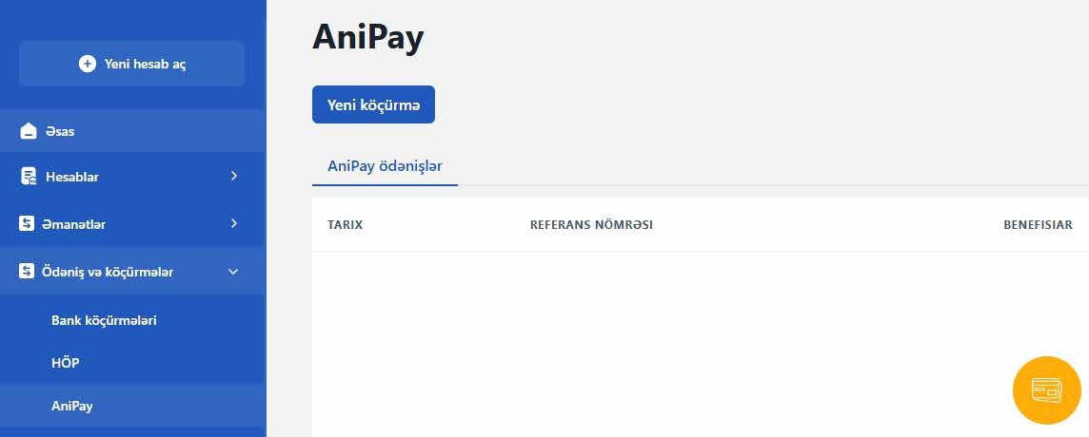
AniPay payments
Terms and conditions :
It is executed as a domestic transfer.
Payments can be made 24/7.
It is possible to carry out a one-time transaction up to 40,000 AZN between business entities.

Slide 17
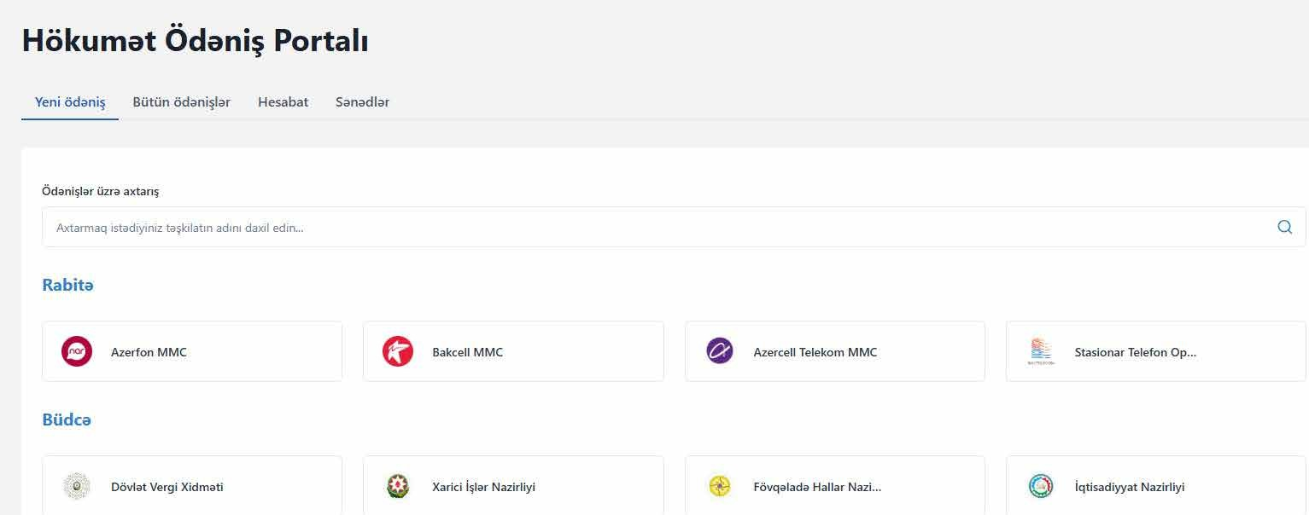
Government Payment Portal (HÖP) payments
Terms and conditions:
It is executed as a domestic transfer.
It is possible to obtain documents and reports related to the payment.

Slide 18
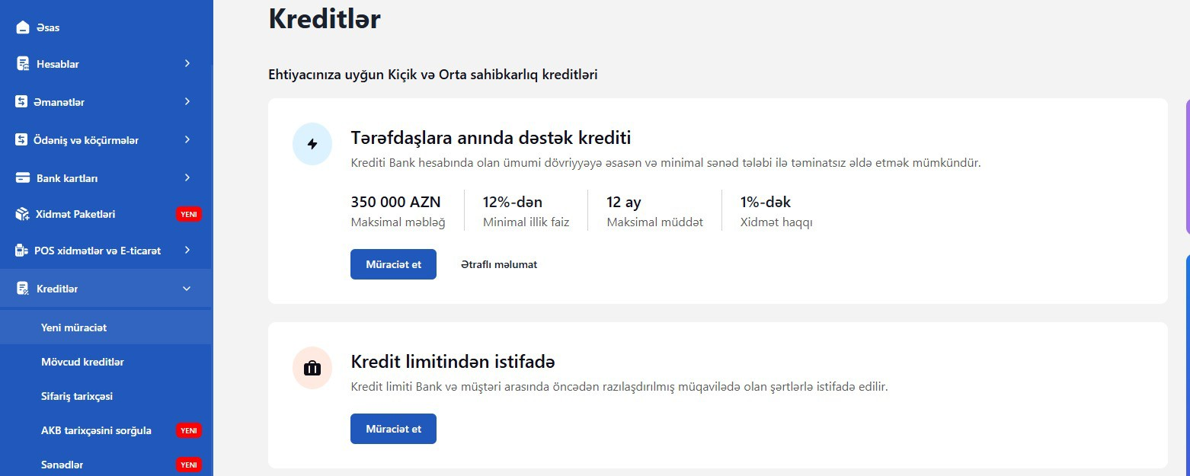
Credit Line Application and Terms
Terms and conditions :
A new credit application and use of the credit line are available.
It is possible to track reports, history, and existing credits related to the loans.
The credit application can be executed by a user with representative authority.

Slide 19
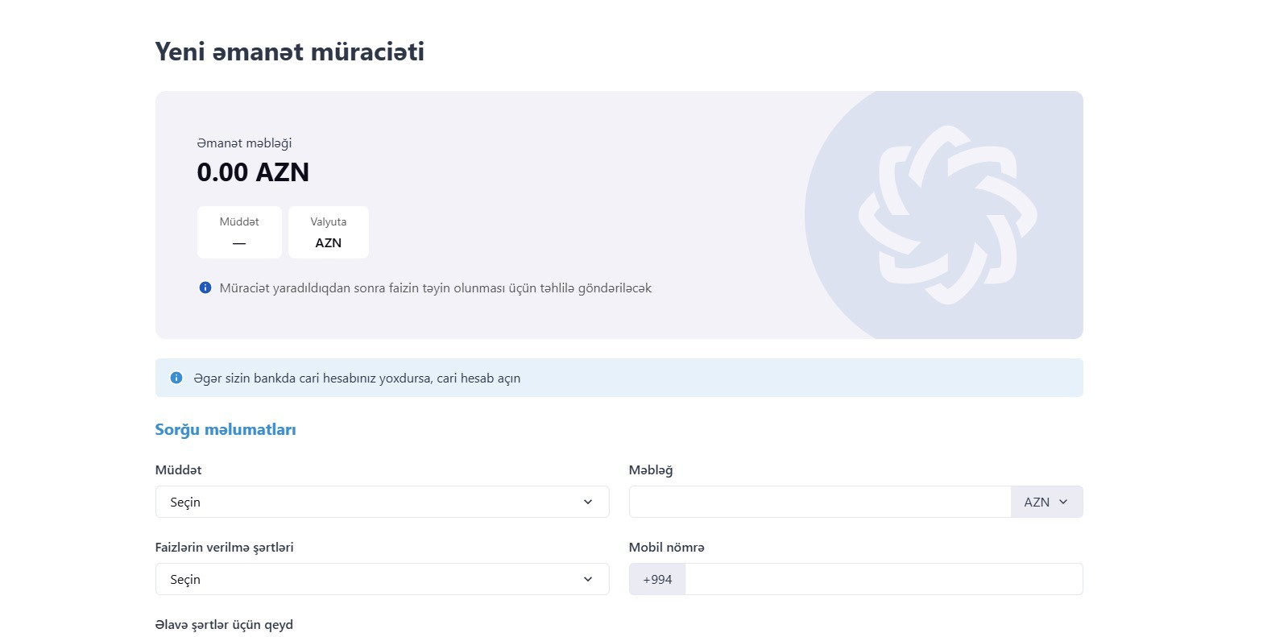
Application and Terms for Deposits
Terms and conditions :
A new deposit application is available.
It is possible to track information and history related to existing deposits.
The deposit application can be executed by a user with representative authority using “ASAN imza”.

Slide 20
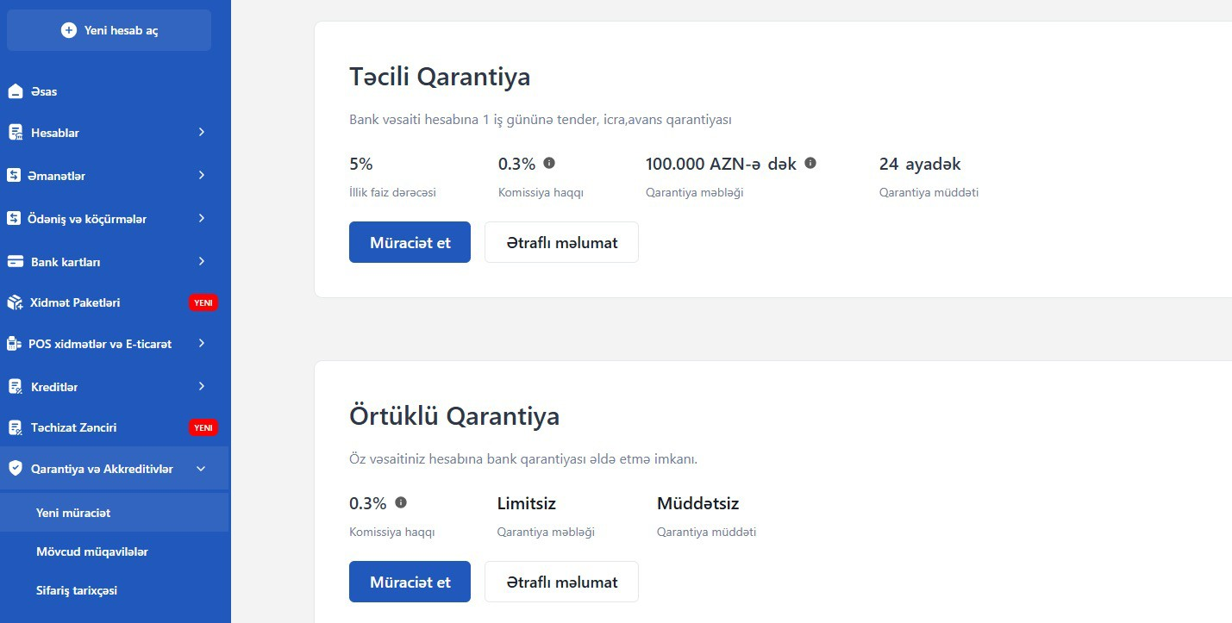
Application and Terms of Guarantees and Letters of Credit
Terms and conditions :
A new guarantee application is available.
It is possible to track the order history and existing contracts related to guarantees and letters of credit.
Applications for guarantees and letters of credit can be executed by a user with representative authority using “ASAN imza”.

Slide 21
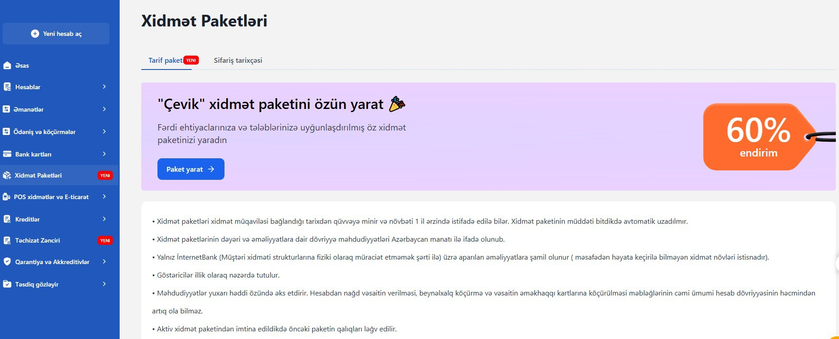
Service packages
Terms and conditions :
Service packages become effective from the date the service agreement is signed and can be used within the following 1 year.
The service package is not automatically renewed after its expiration.
The value of service packages and turnover limits for operations are expressed in Azerbaijani manat.
They apply only to operations carried out via Internet Banking (provided that the customer does not physically visit the service structures) — except for types of services that cannot be performed remotely.
The indicators are intended on an annual basis.

Slide 22
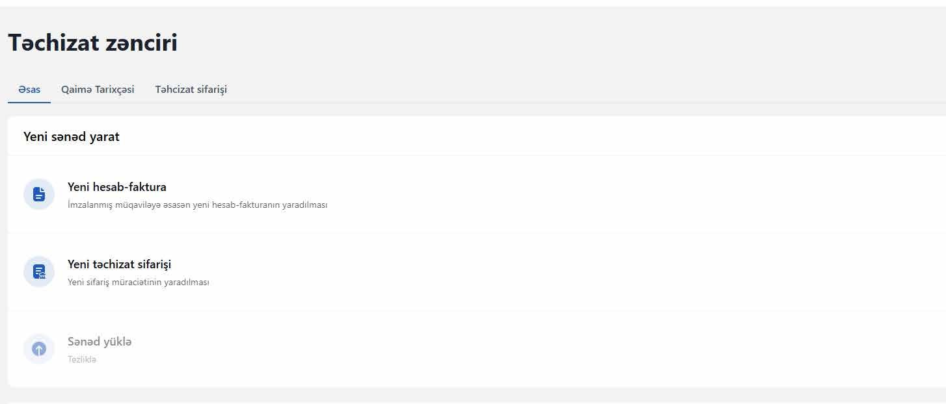
Supply chain
Terms and conditions:
It is possible to create a new invoice and a new supply order in the supply chain.
It is possible to track invoice history and supply orders.

Slide 23
POS services and E-commerce
Terms and conditions:
It is possible to apply for a new POS Terminal, Mobile POS Terminal, and E-commerce.
It is possible to track reports and analytical data related to the service.

Slide 24
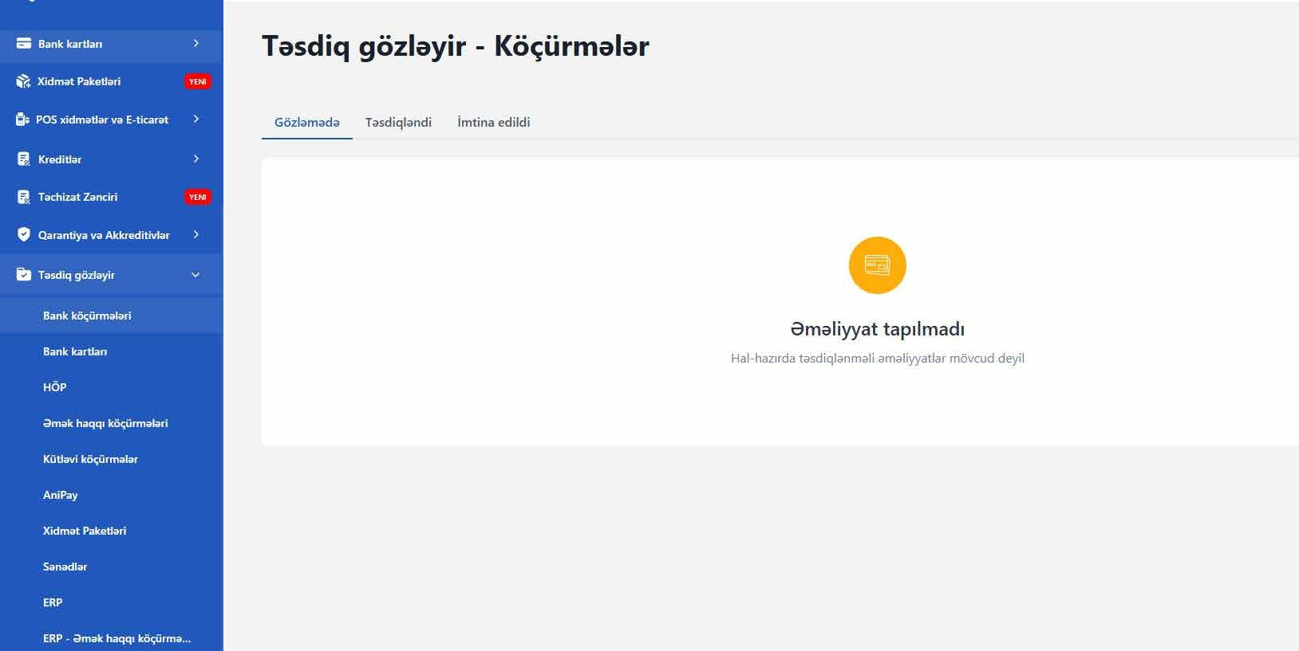
Pending approval section
Terms and conditions:
It is possible to approve and reject operations based on the relevant selection from the section.
It is possible to track operations with the statuses Pending, Approved, and Rejected.

Slide 25
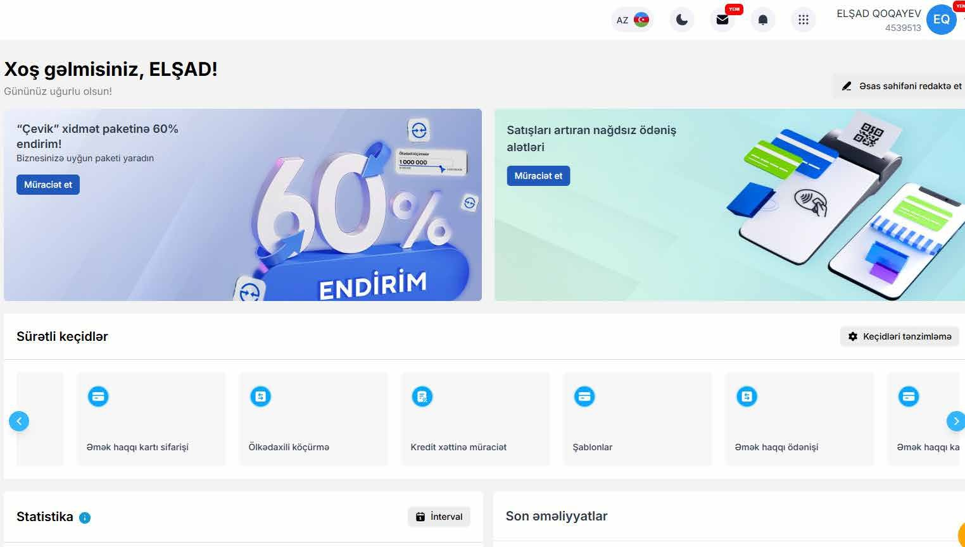
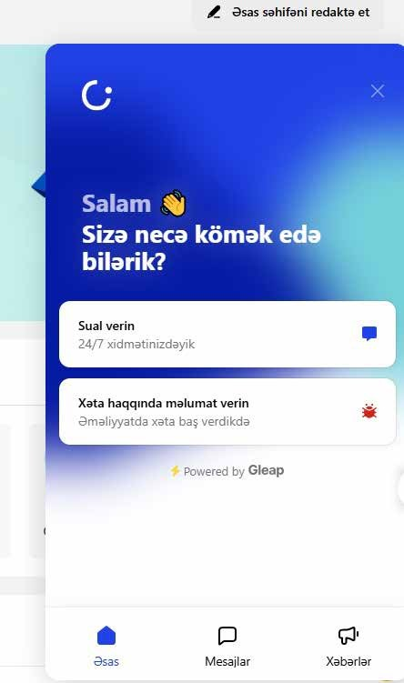
Main page
Terms and conditions:
From the section, it is possible to navigate quickly to the relevant area and obtain information on statistics, exchange rates, and recent transactions.
Questions and inquiries can be addressed via live chat.
Language selection and background light mode adjustment can be made from the main page.

Slide 26
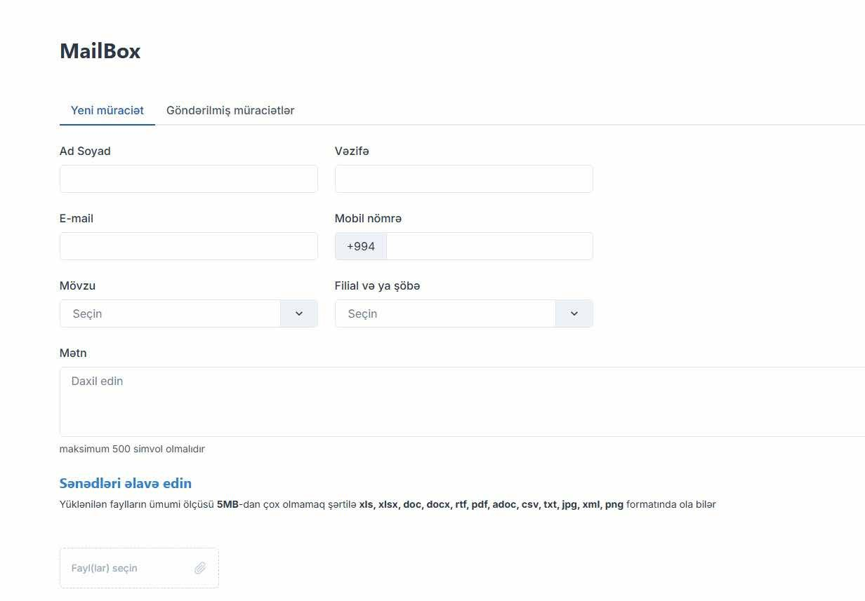
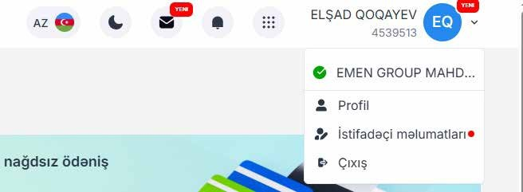
Information regarding mailbox and user
Terms and conditions:
It is possible to monitor the profile and user information of the relevant user from the section.
The mailbox function is provided to the authorized representative user who logs into the Internet Banking service system via ASAN number.

Slide 27
Thank you for your attention!
May 2025

